Slide 1

Mapping the pokemon tcg leaderboard
Daniel Hing
Notes:
Hi, this is my project to map the Play Pokemon Trading Card Game Leaderboard

Slide 2



Goals
To build an interactable map upon which visualizes the data of the top 500 players on the Championship Leaderboard presented by pokemon.com for the Pokémon Trading Card Game (to see which countries are the very best that no one ever was)
Notes:
Starting with what goals that I had for this project. To build an interactive map which visualizes the data that the Championship Leaderboard presented by pokemon.com for the Pokemon Trading Card Game, (to see which countries are the very best that no one ever was)

Slide 3
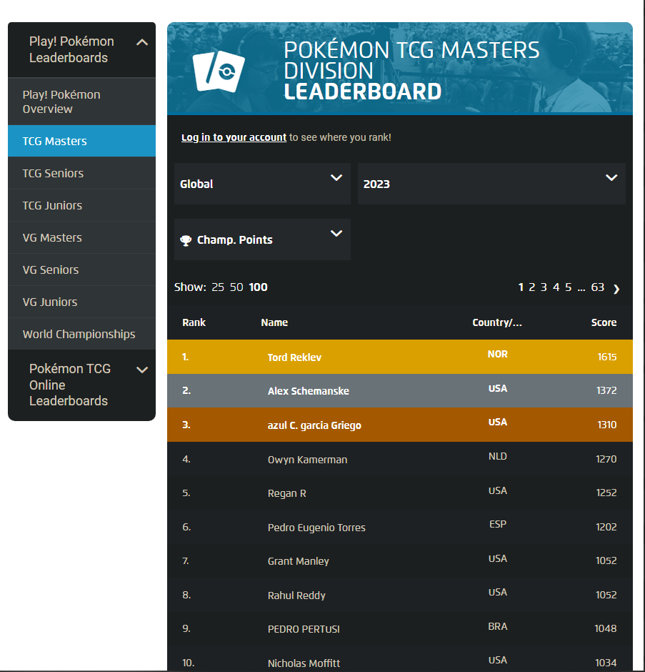

INTRODUCTION
Pokemon handles 4 major tournaments in a year
LAIC
OCIC
EUIC
NAIC
Resulting in the World Championships
The Play!Pokemon Leaderboard provided on pokemon.com
Notes:
An introduction. Pokemon provides several levels of competition across its various games. Similarly to Tennis or Golf a league style accrual of points happen across the season, at 4 major tournaments with minor events occurring between them. Culminating in an invite to the final major event in the year (The World Championships) if performance is strong enough by the end of the season.
To monitor performance of top level players Pokemon provides a leaderboard that continually updates with snapshots of points earned.
I wanted to create a map based on thePpokemon Trading Card Game Masters Leaderboard, one that shows the performance levels of each country as a whole rather than the individual players.

Slide 4

Data Acquisition
Notes:
So my first section of the presentation is a quick dive into the method of how I acquired the data required for my project.

Slide 5

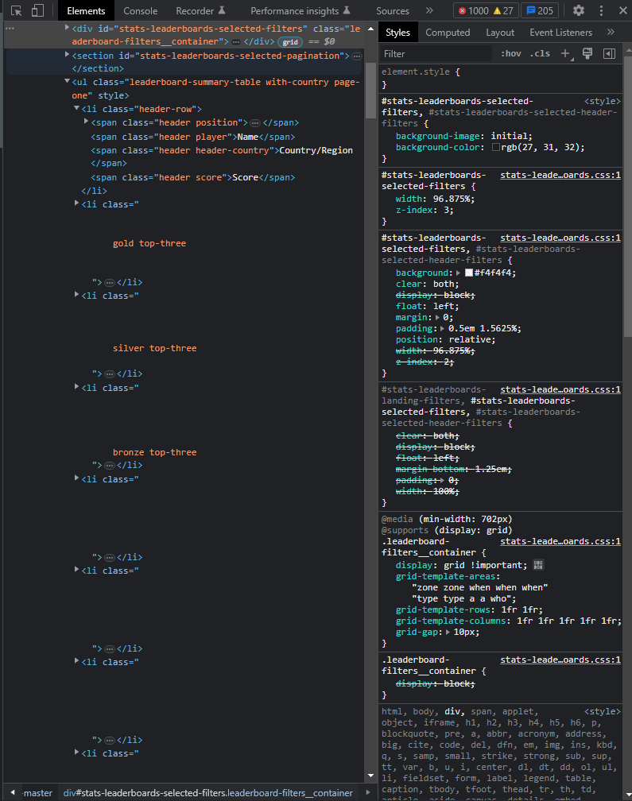
Building a database: Inspecting Data
Used to get name/score/country data
https://www.pokemon.com/us/play-pokemon/leaderboards/tcg-masters/
Python
Use splinter to navigate the HTML
Copy relevant elements into a local HTML
Player Name
Score
Country name/Code
Sourced the top 500 players
2023 as of current
2020 as of end of season
Missing Data for visualization
Coordinates
Notes:
Building a database: Inspecting Data
Pokemon provides a public facing leaderboard at https://www.pokemon.com/us/play-pokemon/leaderboards/tcg-masters/
To acquire this data I utilized python to learn about the structure of the html. Once I learnt about the structure of the data I moved the html into my resources. The usable data was a player name, a score and a country name/country code that each respective player came from.
Notably this did not provide coordinates to each country’s location and so we will have to find that data from another source

Slide 6
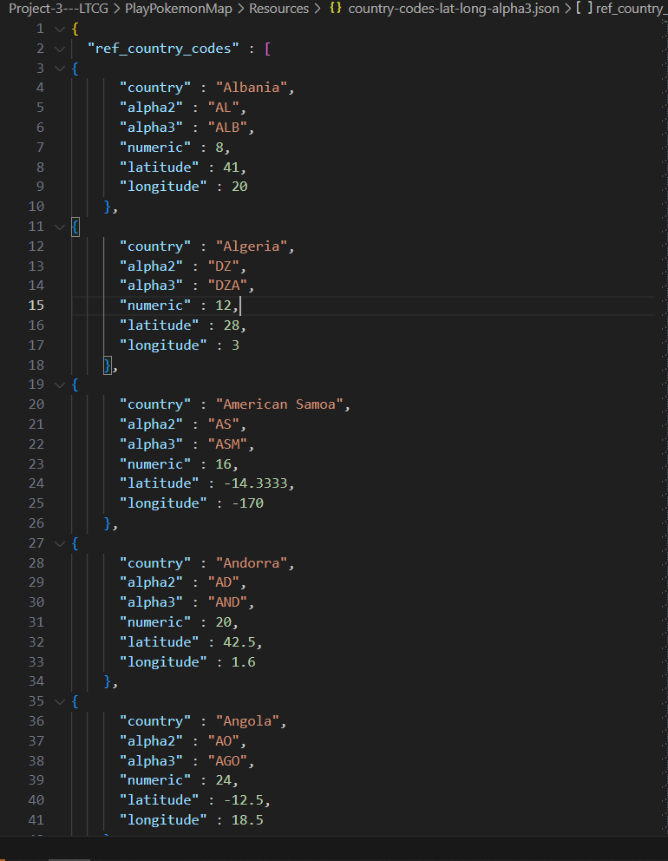

Building a database: Acquiring latitude and longitude
https://gist.github.com/tadast/8827699
CSV
Alpha 3 Codes
Latitude
Longitude
Convert to json
Python
Pair lat/lon on country codes
Set variables
Country
Player Count
Score
Coords
Notes:
Building a database: Acquiring latitude and longitude
I used tadast’s countries_codes_and_coordinates public project found on github which provided a CSV which included Alpha-3 codes, latitude and longitude in its’ data. I converted the document to a json then in python paired the latitude and longitude coordinates with the Pokémon league table data. Then for each country in the list I set empty values for player count and score.

Slide 7
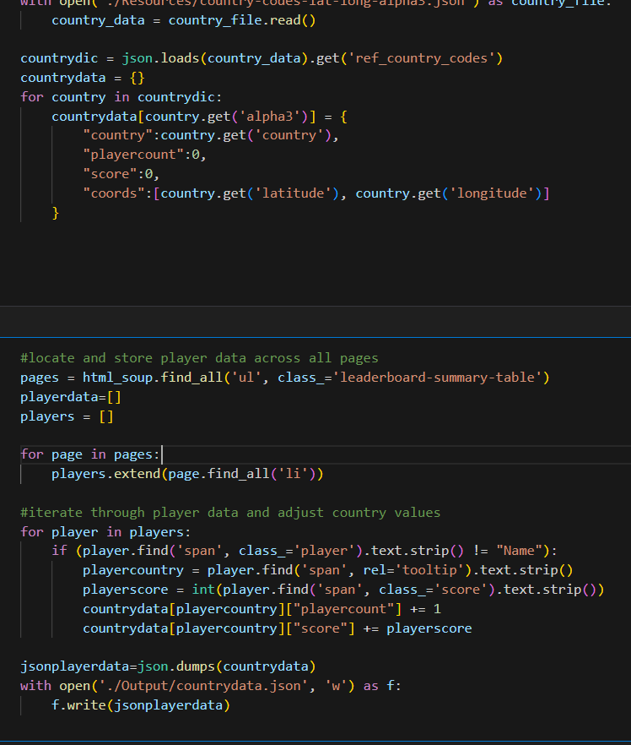

Building a database: Recording Values
Python
Country/Cooordinate data
Player data
Score
Player Count
Write to Json
Notes:
Then it’s a simple matter of taking the updated country and coordinate data and iterating through the player data, storing new values for player count and score and then outputting them to a json

Slide 8
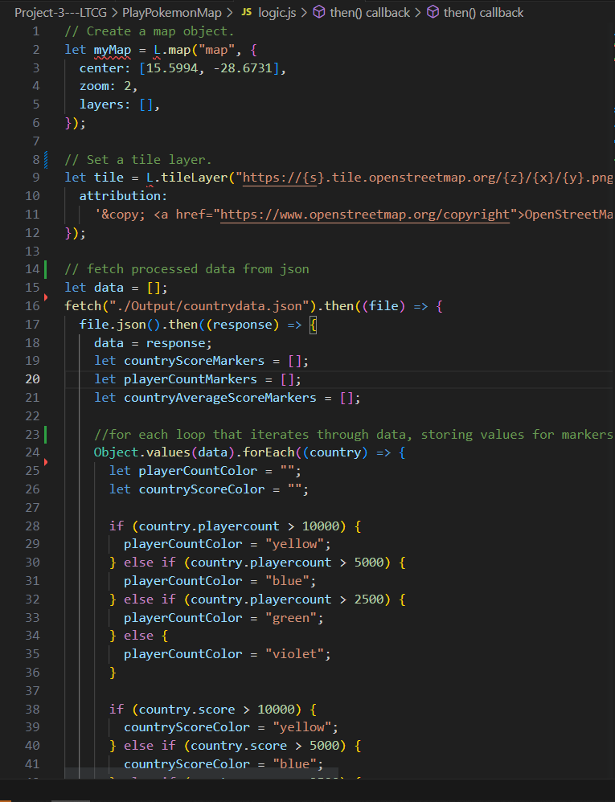

Building a Map
Javascript
Leaflet
Lists
Country Score
PlayerCount
countryAverage
Loop through data
Marker group creation
Based on values
Relevant Popup
Create Overlay Layers
Use markergroups
Create layers for each
Notes:
Using JavaScript and the leaflet library I iterated through the newly built database to build different marker groups representing a country’s total championship points, player count and the average performance.
With those marker groups I created layers that separated “Total Country Score”, Player Count” and “Average Player Score”
I then created a map that utilised these different stored values to create map visualisations that were independently viewable.

Slide 9
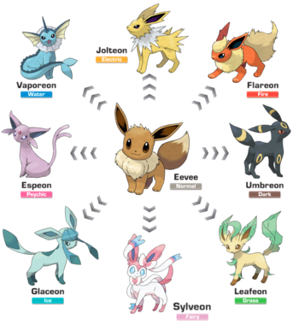
Output
Notes:
So let’s take a look at what all our data finally evolved into!

Slide 10
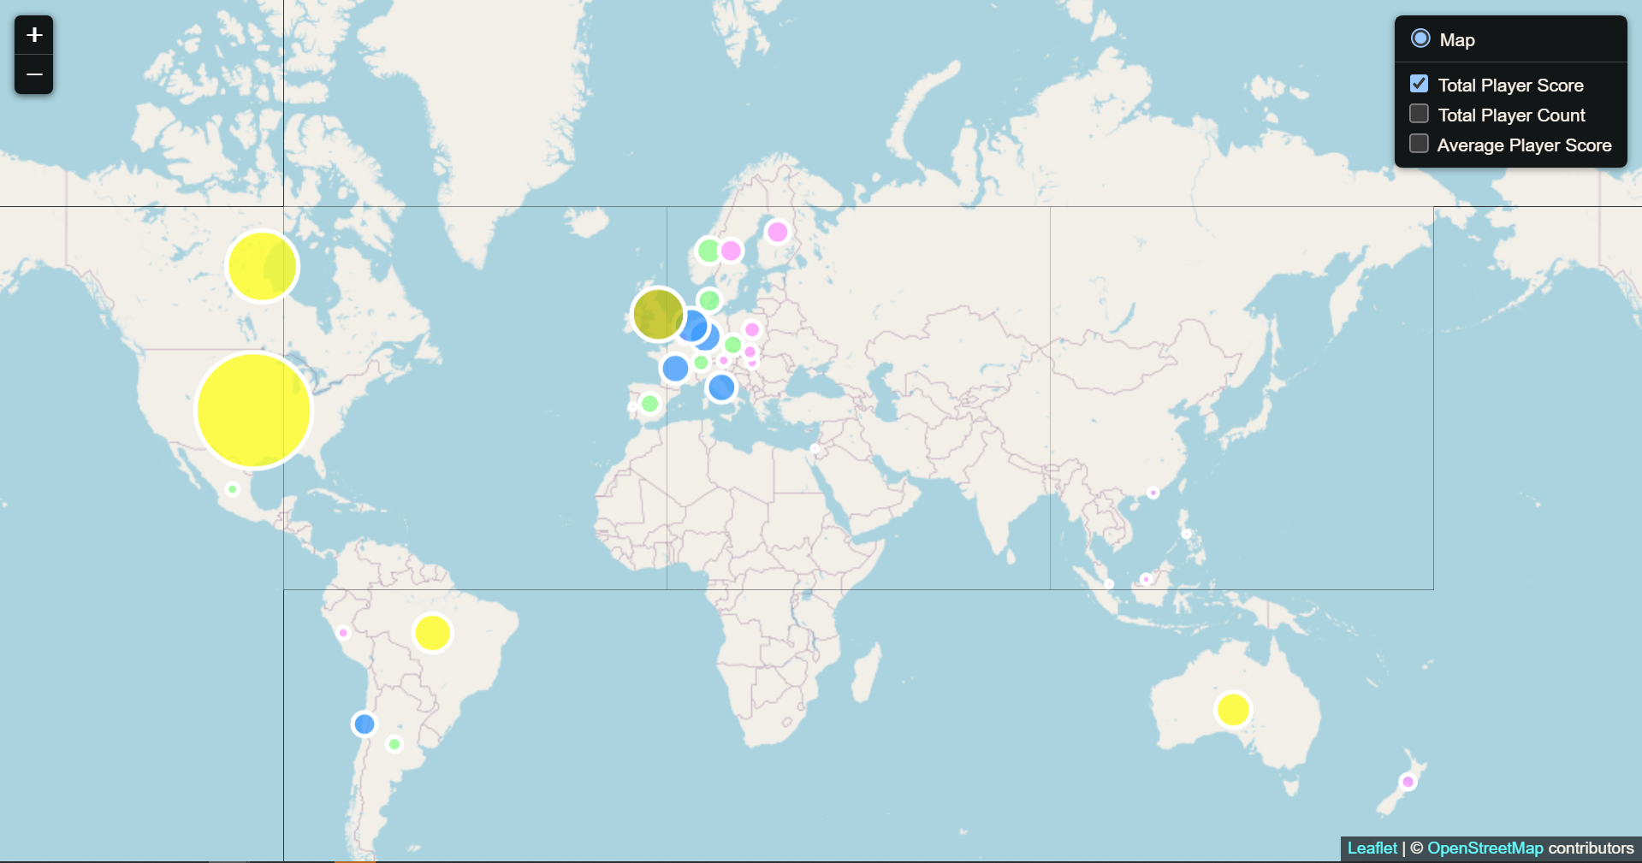
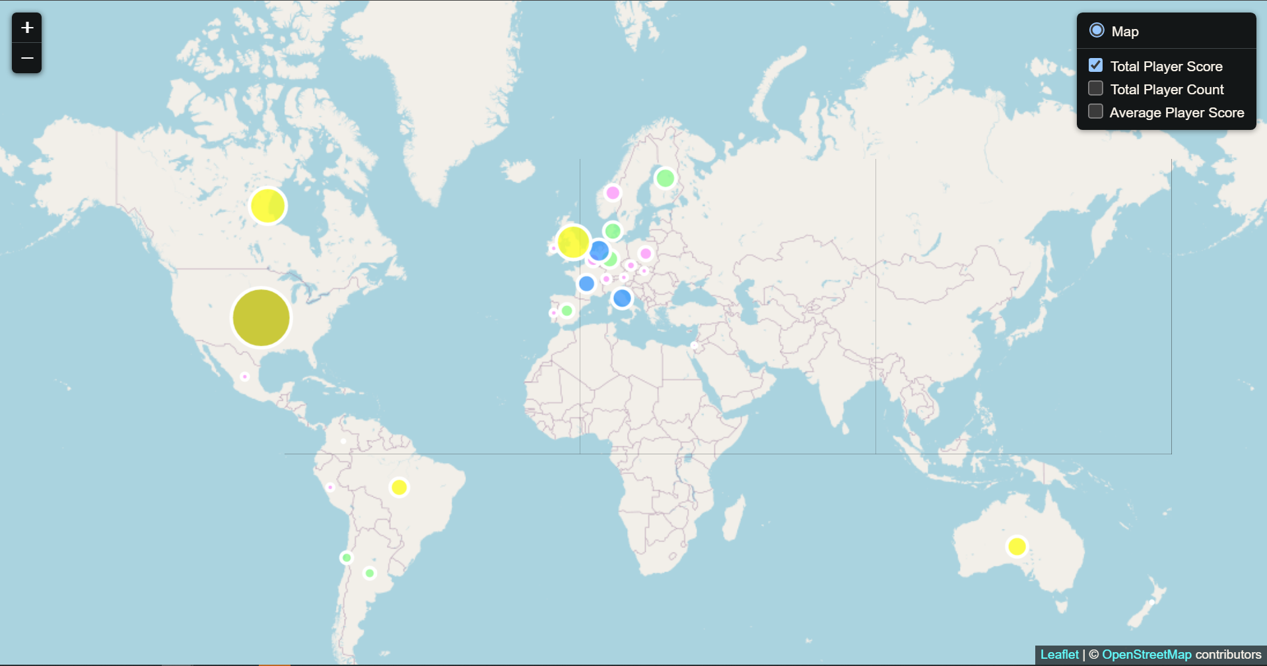
Output for total Player Scores
Output for Player Score in 2020
Output for Player Score in 2023
Major championship point distributing events – LAIC, OCIC, EUIC, NAIC
NAIC due for 30/06/23 – 2/07/23
Notable absences
Japan
China
SEA
Notes:
The visualization of Total Player Score in the pre covid era vs post covid era doesn’t show significant differences between time periods
It’s worth noting that there are geographical correlations between countries with higher scores and the 4 major point giving events (Latin American International Championships (Brazil), Oceanic International Championships (Melbourne/Sydney), European International Championships (EU) and North American International Championships(USA)).
Total player score in the 2020 map is higher than the current due to one major event (NAIC) not occurring yet. Thats set to be held on June 30th of this year, so those points haven’t been distributed into the league ecosystem, and so the 2023 mmarkers are generally smaller than their 2020 counterparts.
There are some noticeable absences, which are very easy to see visually when laid out on a map like this. Those of Japan and China despite having very strong pokemon fanbases are absent on this map.
Japan-Home of pokemon. They participate in the final major event of the year (the world championships) but their qualification route for Worlds does not go through the Play Pokemon league that the other countries participate in. They have their own weekly and quarterly events known as City Championships, and so do not feature on the Play! Pokemon leaderboard and thus the map.
China and South East Asia-Pokemon as a TCG was only recently introduced to mainland China. This has resulted in China being a few years behind the rest of the world’s distribution as they push through sets of cards to catch up before they can participate in global events. Notably Hong Kong and Taiwan used to participate in events but now have their own qualification system for Worlds, similar to Japan, which was introduced in 2020, and so those blips are no longer present from the 2023 visualization.

Slide 11
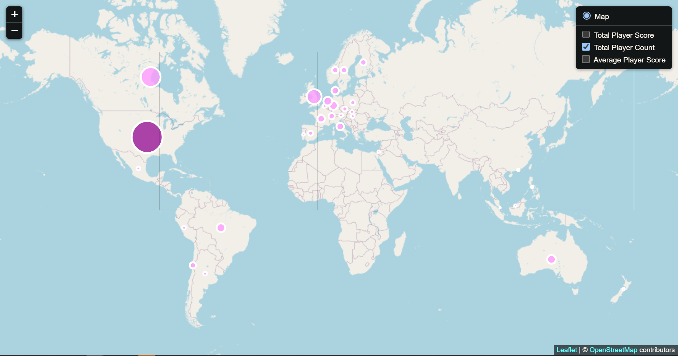
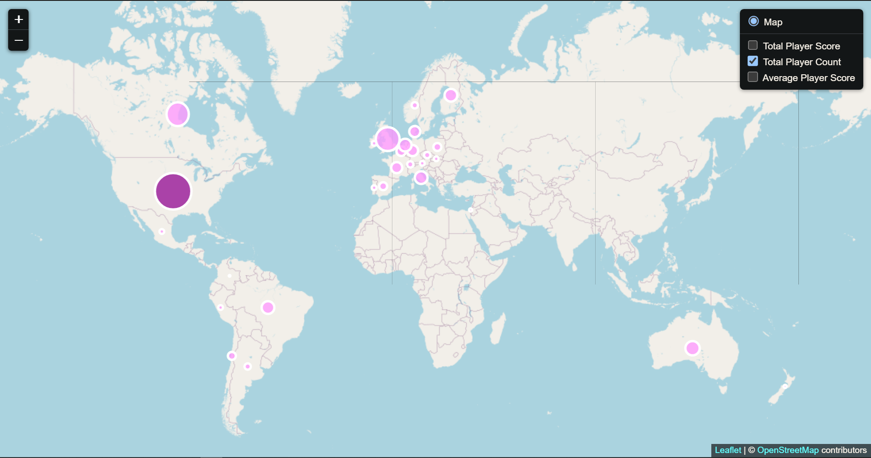
Output for Country Player Count in top 500
Output for Player Count ins 2020
Output for Player Count in 2023
Exceptions
Berlin/London EUIC 2020/2023
LatAm and Oceania
Smallest of the 4 major regions
Economic or Demographic causes
Notes:
Output for Country Player Count in top 500
We can learn a few more things.
It is worth noting that while the wider geographical location of host countries seems to correlate to players counts in the top 500, the effect is only a trend not a rule. For example between the two sample sets, 2020’s EUIC was hosted in Berlin, Germany, whereas 2023’s was hosted in London, UK. In 2020 11 players from Germany made the top 500 whereas in 2023 13 players from Germany made the worldwide top 500. The ease of travel within Europe means that as a whole performance is not correlated beyond being European.
Between 2020 and 2023 the top 500 mostly consisted of players from the same countries.
Of the 4 regions, Latin America and Australia have the smallest representation. I think this is due to the cost of travel and relative wealth compared to the other regions for Latin American countries. To receive travel stipends and subsidies to attend the next major event from Pokemon, they need to perform at a high level at each tournament (one tournament result leads into subsidies for the next tournament and so on ), whereas the number of players in Europe and North America that can afford travel out of pocket is higher. For Australia we actually have outsized representation in the hobby despite our small population, an example of how various factors can influence results.

Slide 12
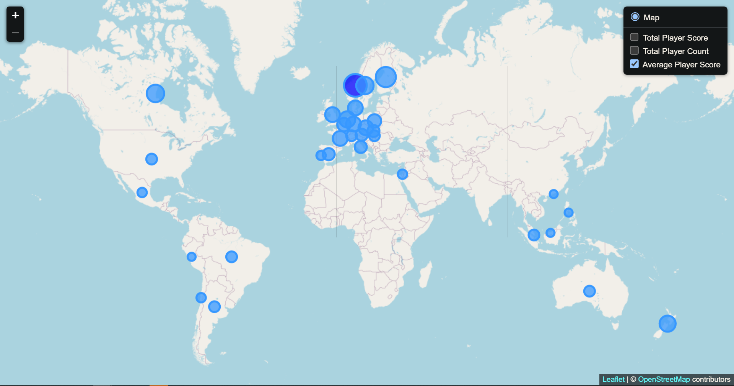
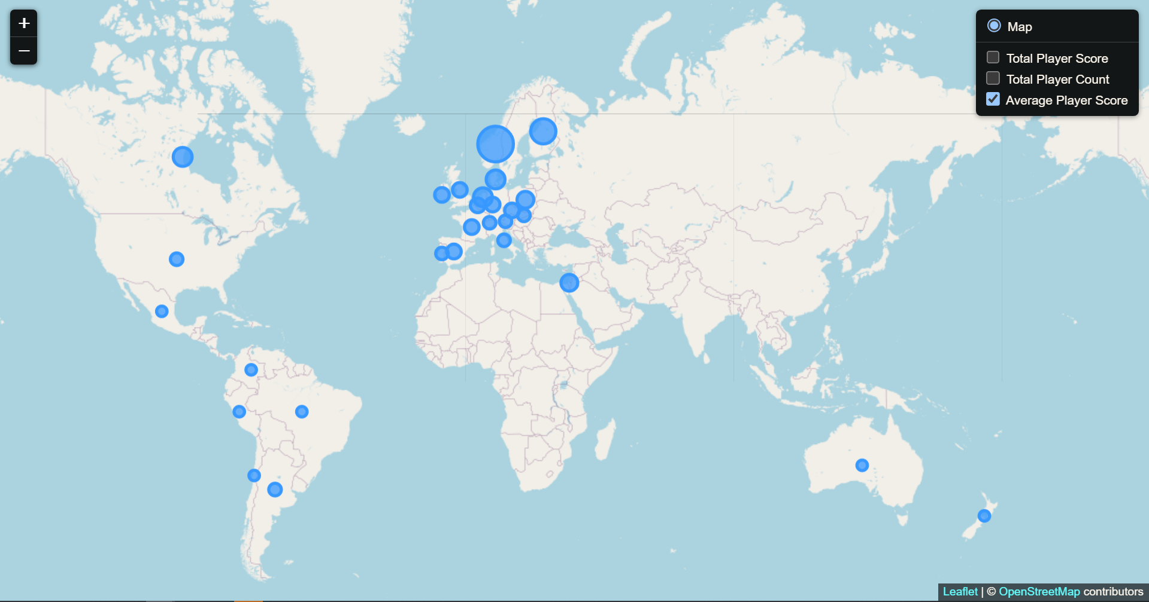
Output for Average Player Score
Output for Average Player Score in 2020
Output for Average Player Score in 2023
Differences to previous data visualizations
Outliers
Norway
Lack of SEA
Notes:
Output for average player score paints a different picture to the other 2 relatively similar data sets. With this we can see that performance across the world is less varied. The outlier and best performing country is Norway. This is due to the player count in the top 500 for Norway being very low, but those players being among the highest ranking (ie Tord Reklov current rank 1 player).
It’s also very clear now that SEA has been removed as a region from the circuit post 2020. This is due to Pokemon introducing a separate league/circuit for the region in the years between the two visualizations, removing them from the leaderboards, removing them from the map.

Slide 13

Relevance Discussion of study
Conclusions
Visualisations
Demonstrate changes
User access
Changes
Moving data to single database and map
Including more series based data (time)
Changing the end user
Rather than countries/player performance data
Data that would be useful to event hosts
Notes:
In conclusion, despite the relatively frivolous nature of the project, I demonstrated that good usage of visualisations can allow users to quickly identify and demonstrate real world differences and changes in data. Through use of visual data we could identify patterns and the presence or lack thereof of map activity had real world implications.
Given time this project could take on a number of improvements or adaptations.
The final visualisation output could be put into a single map with drop downs for not only 2020 and 2023 but all the snapshots shown on the Pokémon League website dating back to 2014.
My focused user for my project was competitive players. Hence the data pulled was based on top 500 players and the metrics competitive players care about. If I were to change the focus to event hosts/TPC itself the data set may care less about the top performing players and more about total players. Regional information about total player counts not limited to the top 500 could provide valuable information regarding booking event locations and finding suitable cities and travel hubs with the infrastructure to host large pokemon events.

Slide 14

Bibliography
Play! Pokemon Leaderboards<https://www.pokemon.com/us/play-pokemon/leaderboards/tcg-masters/>
User Tadast’s Country Database<https://gist.github.com/tadast/8827699/>
Notes:
So these are links to the two sites used in the project.

Slide 15
THANK YOU
Notes:
Thank you for (mandatorily) attending our presentation! It was a lot of fun to make both while researching the topic and actually putting together the code.

